Slide 1
Student Report Card System
C++ Project
By Group Ideals
Department of Computer Science & Software Engineering
Sukkur IBA

Slide 2
By Group Ideals
Shahzeb
Shakeel Ahmed
Jamal Hussain
Sajan Das
M. Suleman

Slide 3
Scope of the Project
This Project is made to keep records of schools and other institutes.
Records are kept more securely than paper based records.
Records are easily maintained and modified.
Search of any specific record is very easy.
This project is very easy to operate.

Slide 4
Program Requirements
Compiler; Dev C++
Operating System; Windows xp, 7, 8 or 10
RAM; 512 MB to 2 GB
Processor; Dual core to Core i7
Storage usage; 1 MB to 5 MB

Slide 5
Concepts used in Source Code
Structure
Arrays
Filing System
User Defined Functions
Pre-defined Functions
Loops & Condition Statements

Slide 6
Flow Chart
Main Menu
Result Menu
Class Result
Student Report Card
Entry/Edit Menu
Create Record
Exit
Display All Students
Search Student
Delete Student
Modify Student

Slide 7
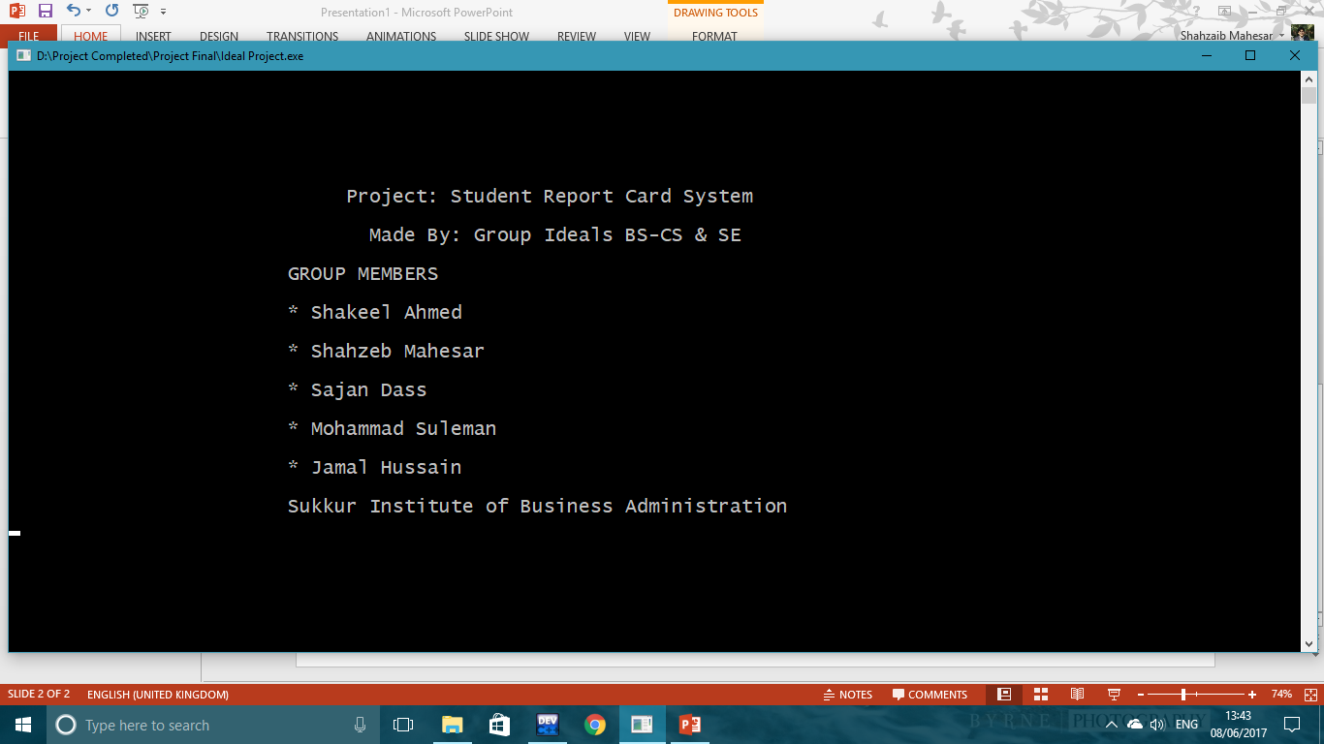
First of Screen of Program(Intro Function)

Slide 8
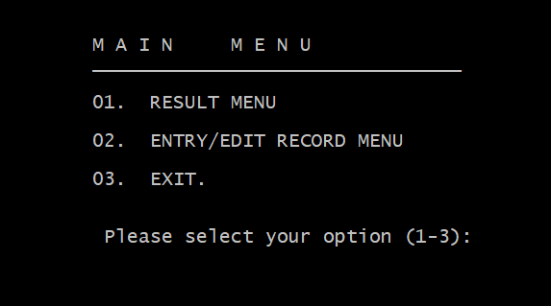
2nd Screen of the Program(main menu)

Slide 9
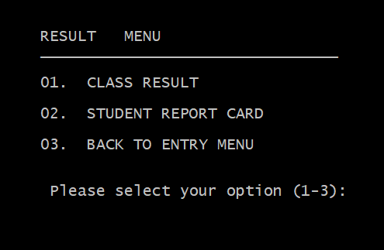
Result menu

Slide 10
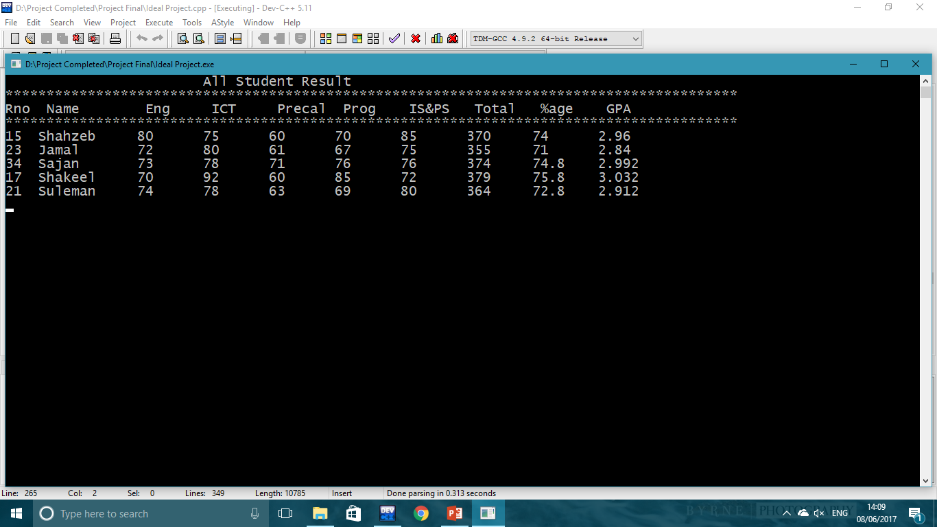
Class Result (All Student Record)

Slide 11
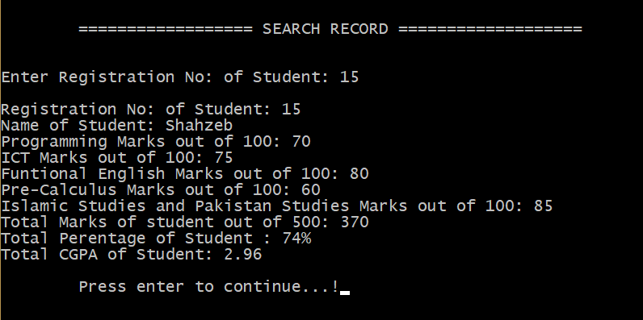
Student Report Card (Specific Student)

Slide 12
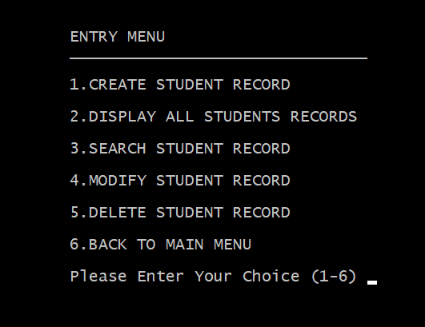
Entry/Edit Record Menu

Slide 13
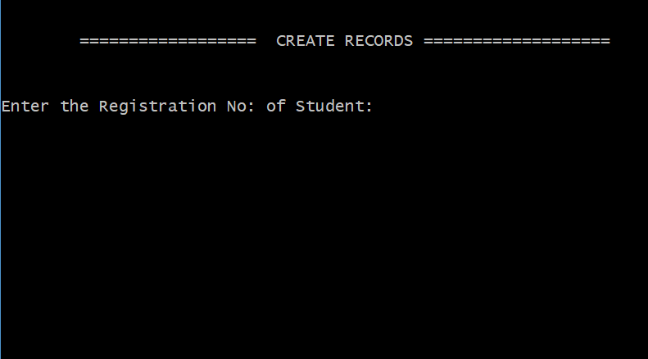
1st Function ( Create Student Record)

Slide 14
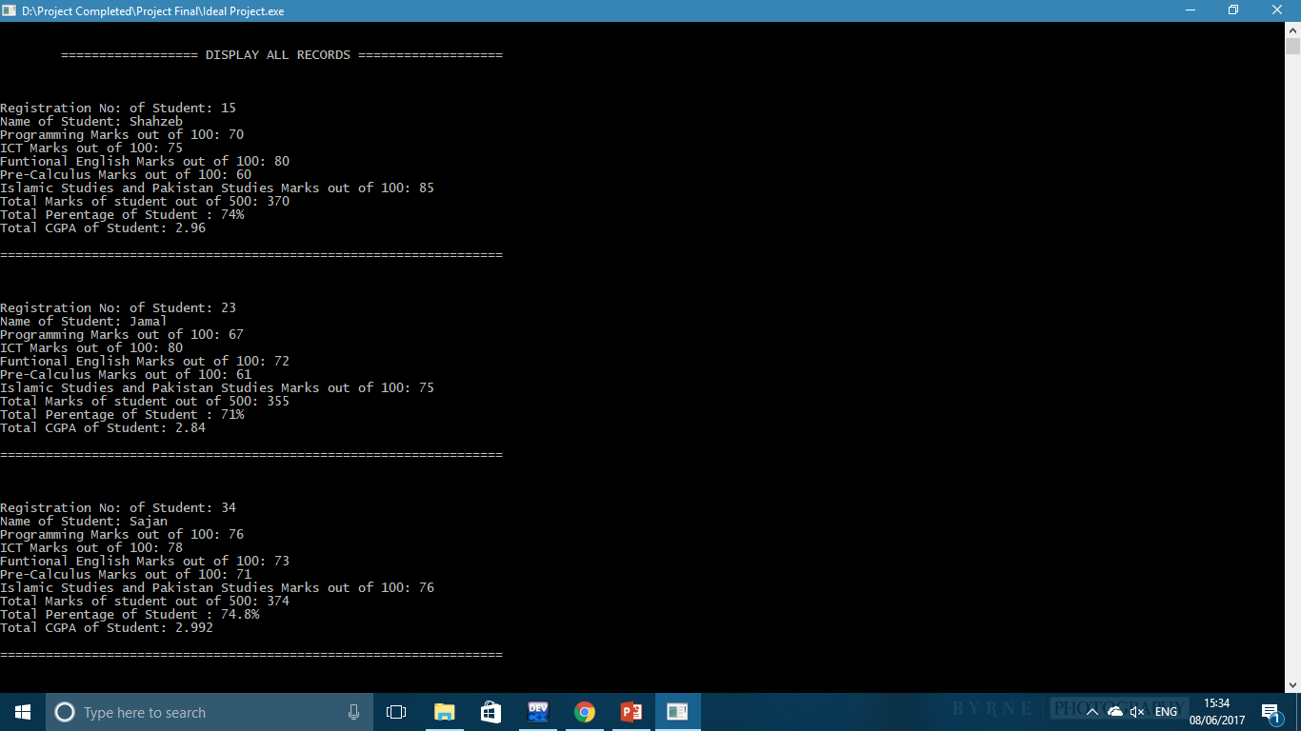
2nd Display All Students Records

Slide 15
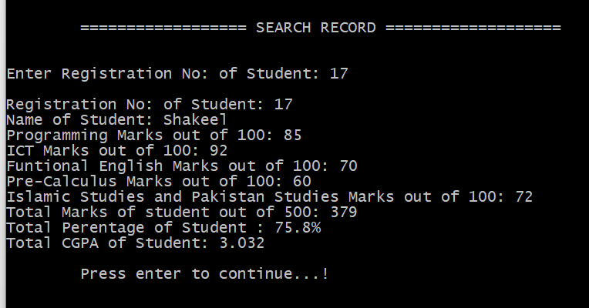
3rd Search Student Record(Specific Search)

Slide 16
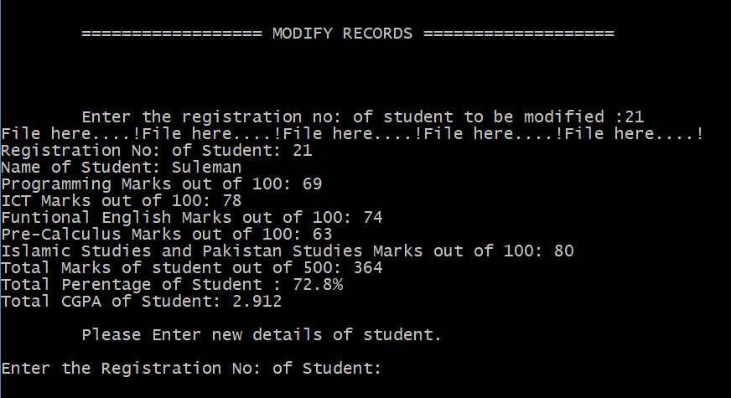
4th Modify Student Record (Specific Student)

Slide 17
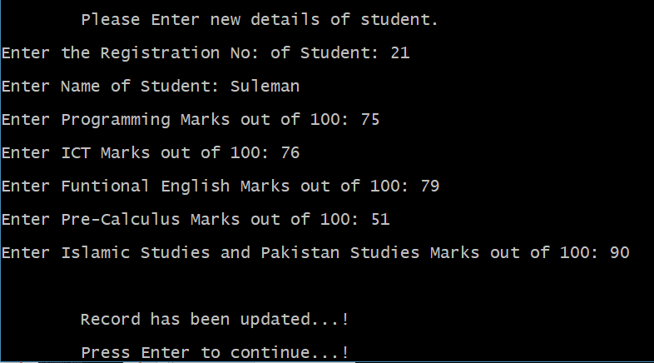
4th Modify Student Record (Specific Student)

Slide 18
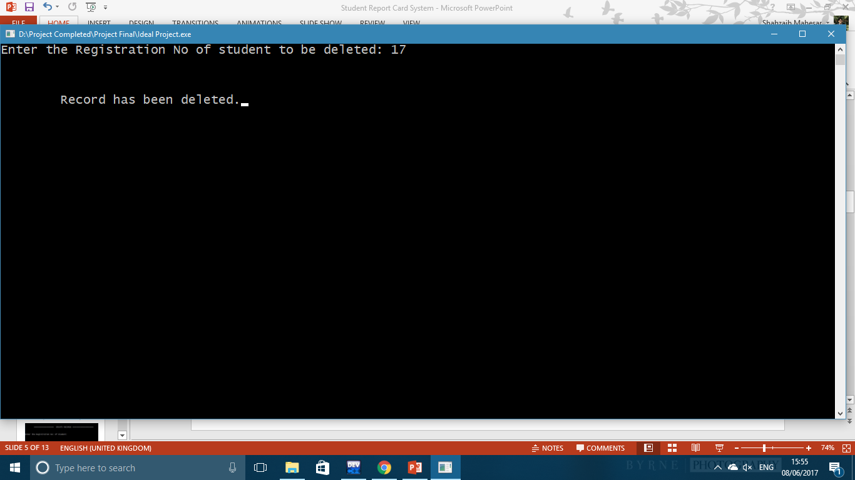
5th Delete Student Record (Specific Student)

Slide 19
Thanks…..

